Slide 1
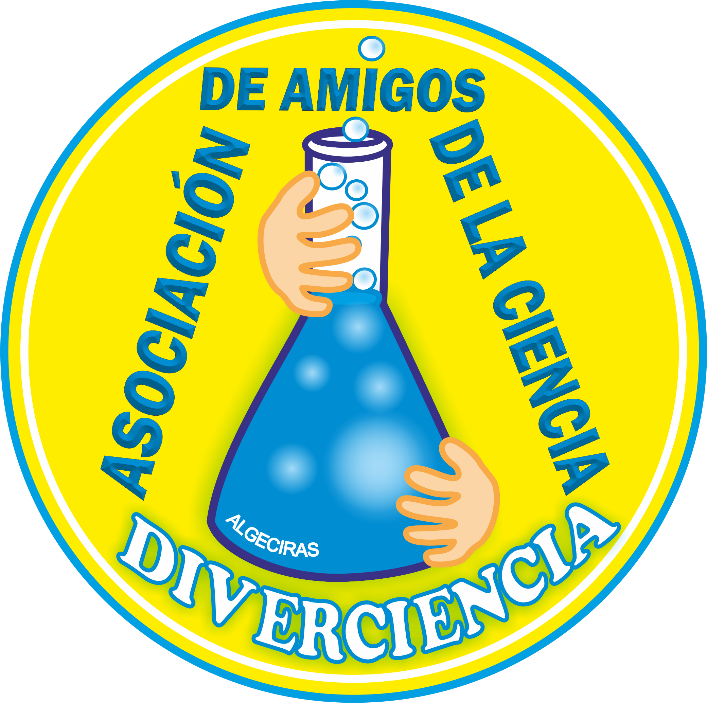
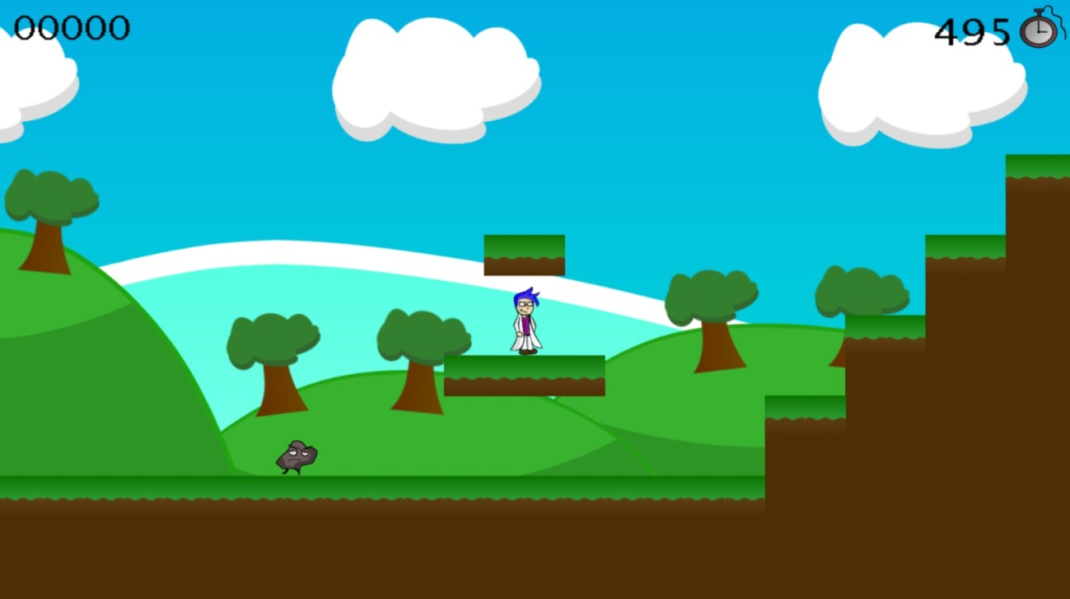
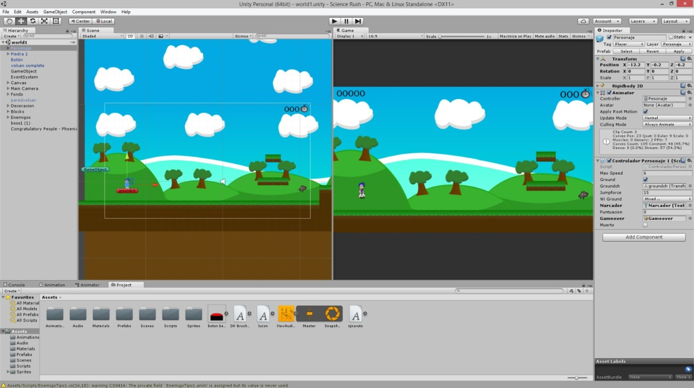
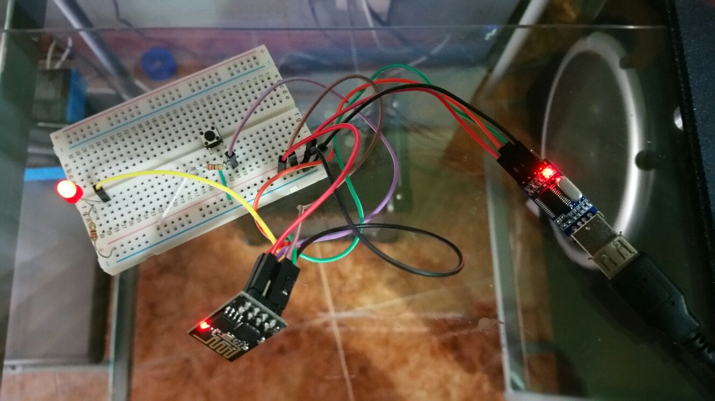
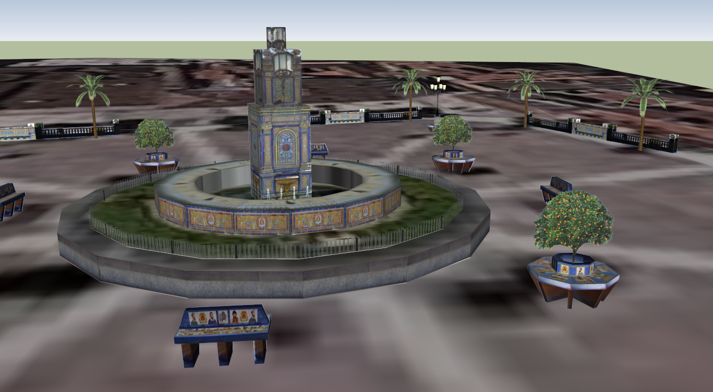
Ecología y Medio Ambiente
Francisco Rivera González | I.E.S. Kursaal | Algeciras | Spain
Techno-Lab Kursaal
Workshops about technology to improve our society
(contact: kursaal@gmail.com)
These projects are carried out in the breaktimes and voluntarily, with workshops without age treating. These try to resolve specific problems to improve the live of all student´s enviroment, independing of their difficulties. Older student help the younger ones. Participating students helps in class when we are teaching topics related to our projects. Projects:
1) Not for dummies: a game to learn about differents subjects.(STEM)
2) How is Algeciras?: To show information
about our city in visual and sonorous
support.(3D,AR,etc..) .
3) Control of devices by voice
4) Simple projects with sensors
Gamification as a educational methodology.
Geological Universe.
Plug that connects and disconnects itself with the voice.
View in 3D of the main square of Algeciras.
100%
Great!
We learn technology to try to improve our society, we do a “Social Technology“.
“I see a problem, I share it and we solve it. Methodology: learning by doing”

